Slide 1
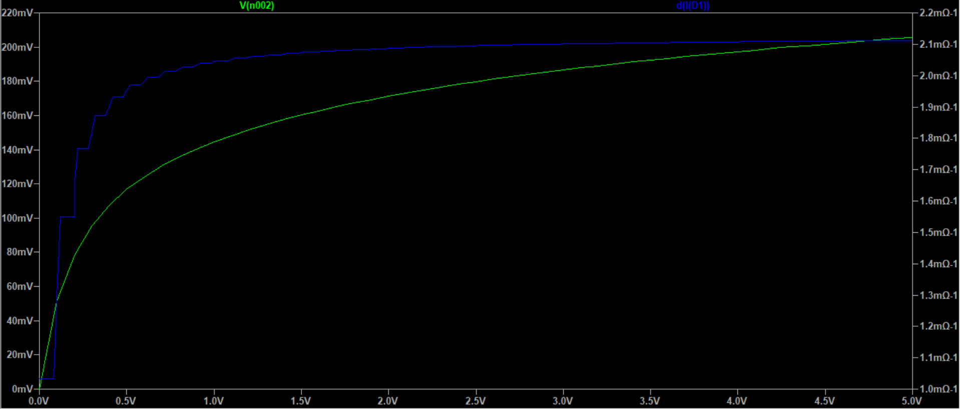
Exercise E4
For the 1N5817, the main difference lies in that it seems to have a way smaller forward voltage than 1N914.

Slide 2
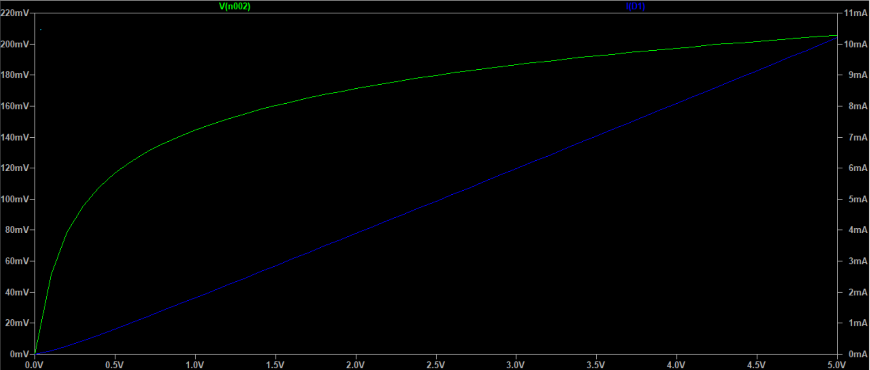
Exercise E4

Slide 3
Exercise E4
https://www.diodes.com/assets/Datasheets/1N5817-1N5819.pdf
At 5V, with around 10mA max current, we cannot reproduce the results listed in the specification. However, given that the forward voltage seems to rise with the current, and that it’s 0.450V at I=1.0A, our prediction that the forward voltage is very small is correct.
However if the model is changed to having a 0-50V voltage swipe and a 47 Ohms resistor, we can indeed reach I=1.0A.

Slide 4
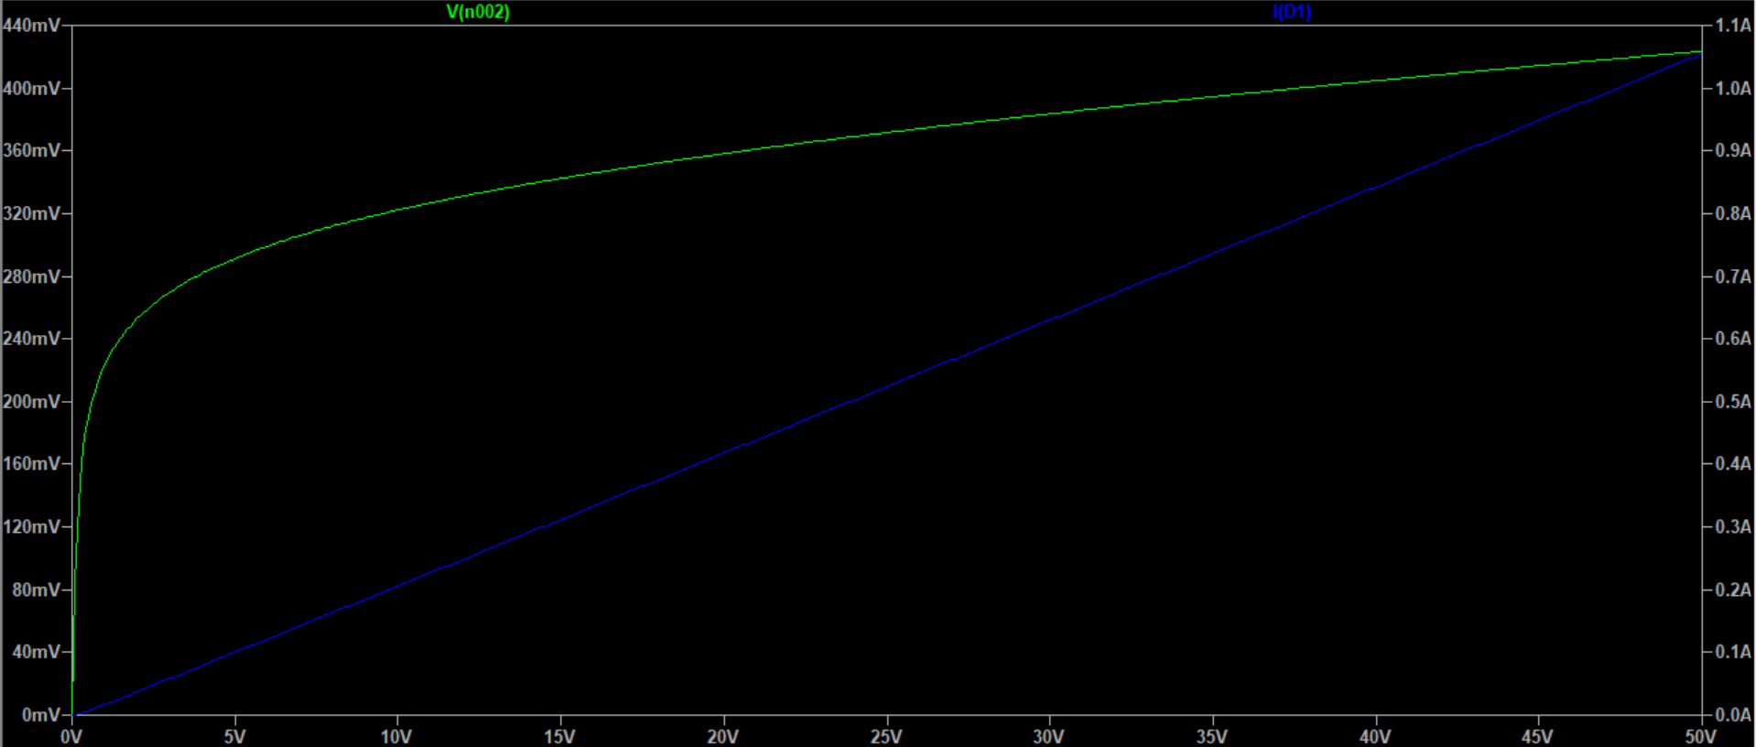
Exercise E4

Slide 5
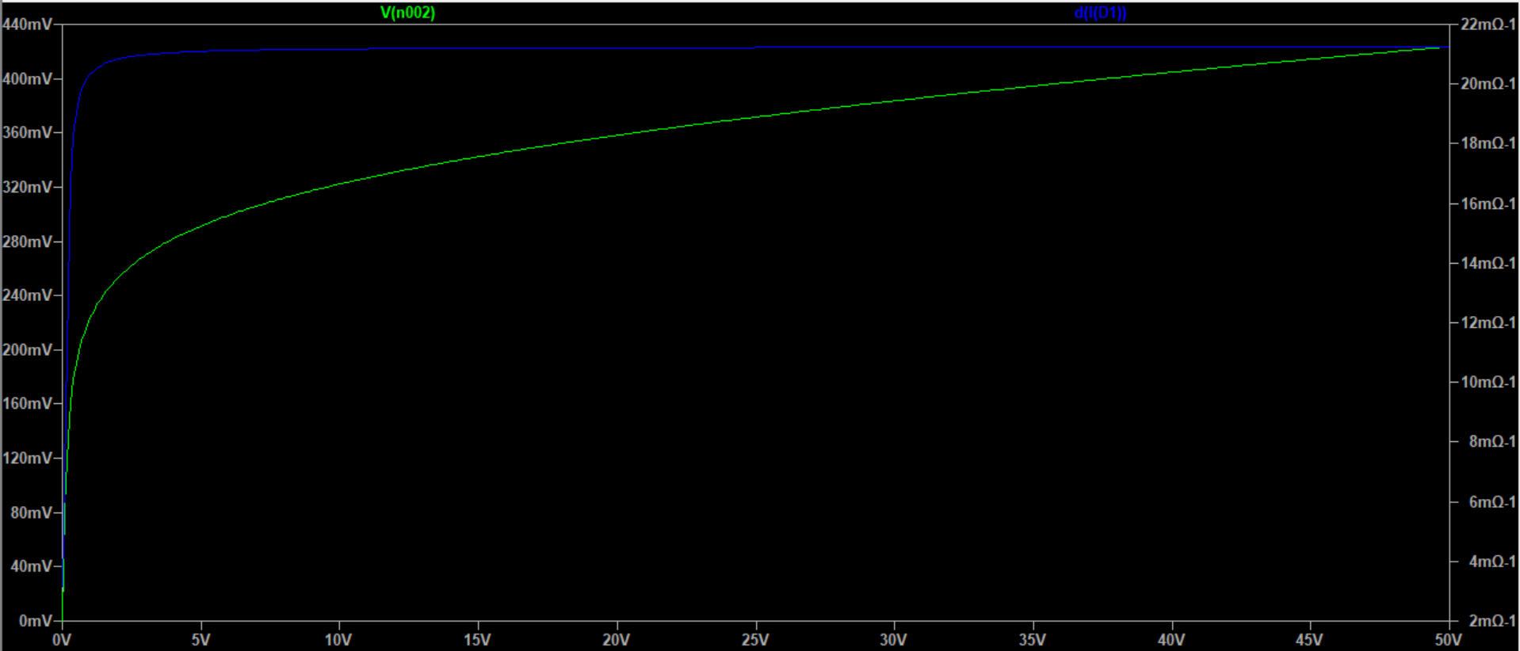
Exercise E4

Slide 6
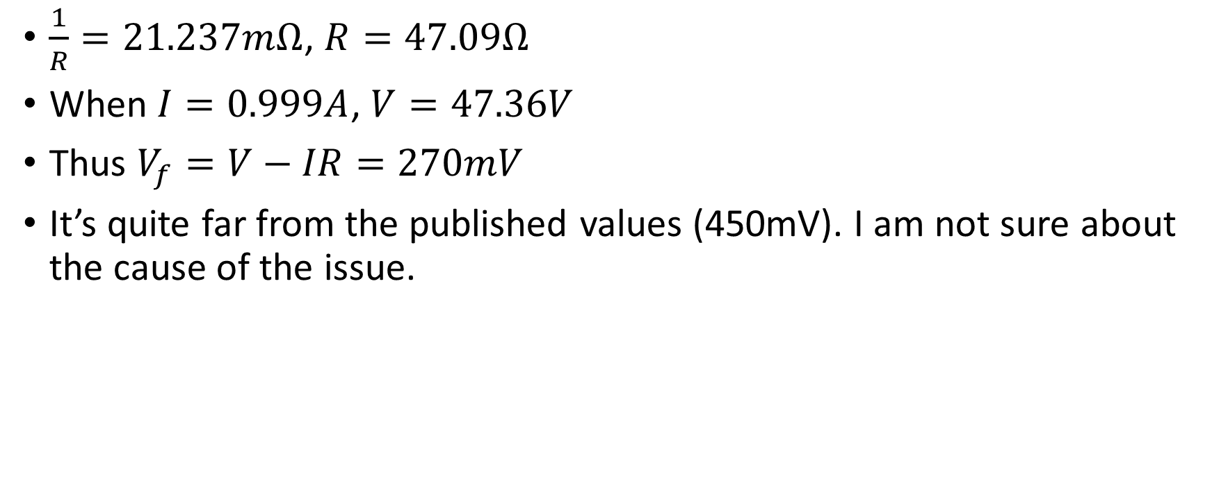
Exercise E4
$\frac{1}{R}=21.237mΩ$, $R=47.09Ω$
When $I=0.999A$, $V=47.36V$
Thus $V_{f}=V−IR=270mV$
It’s quite far from the published values (450mV). I am not sure about the cause of the issue.

